Slide 1
Virus Validate
Group 5
James Bui
Sonya Shin
Michelle Her
Justin Djojomartono

Slide 2
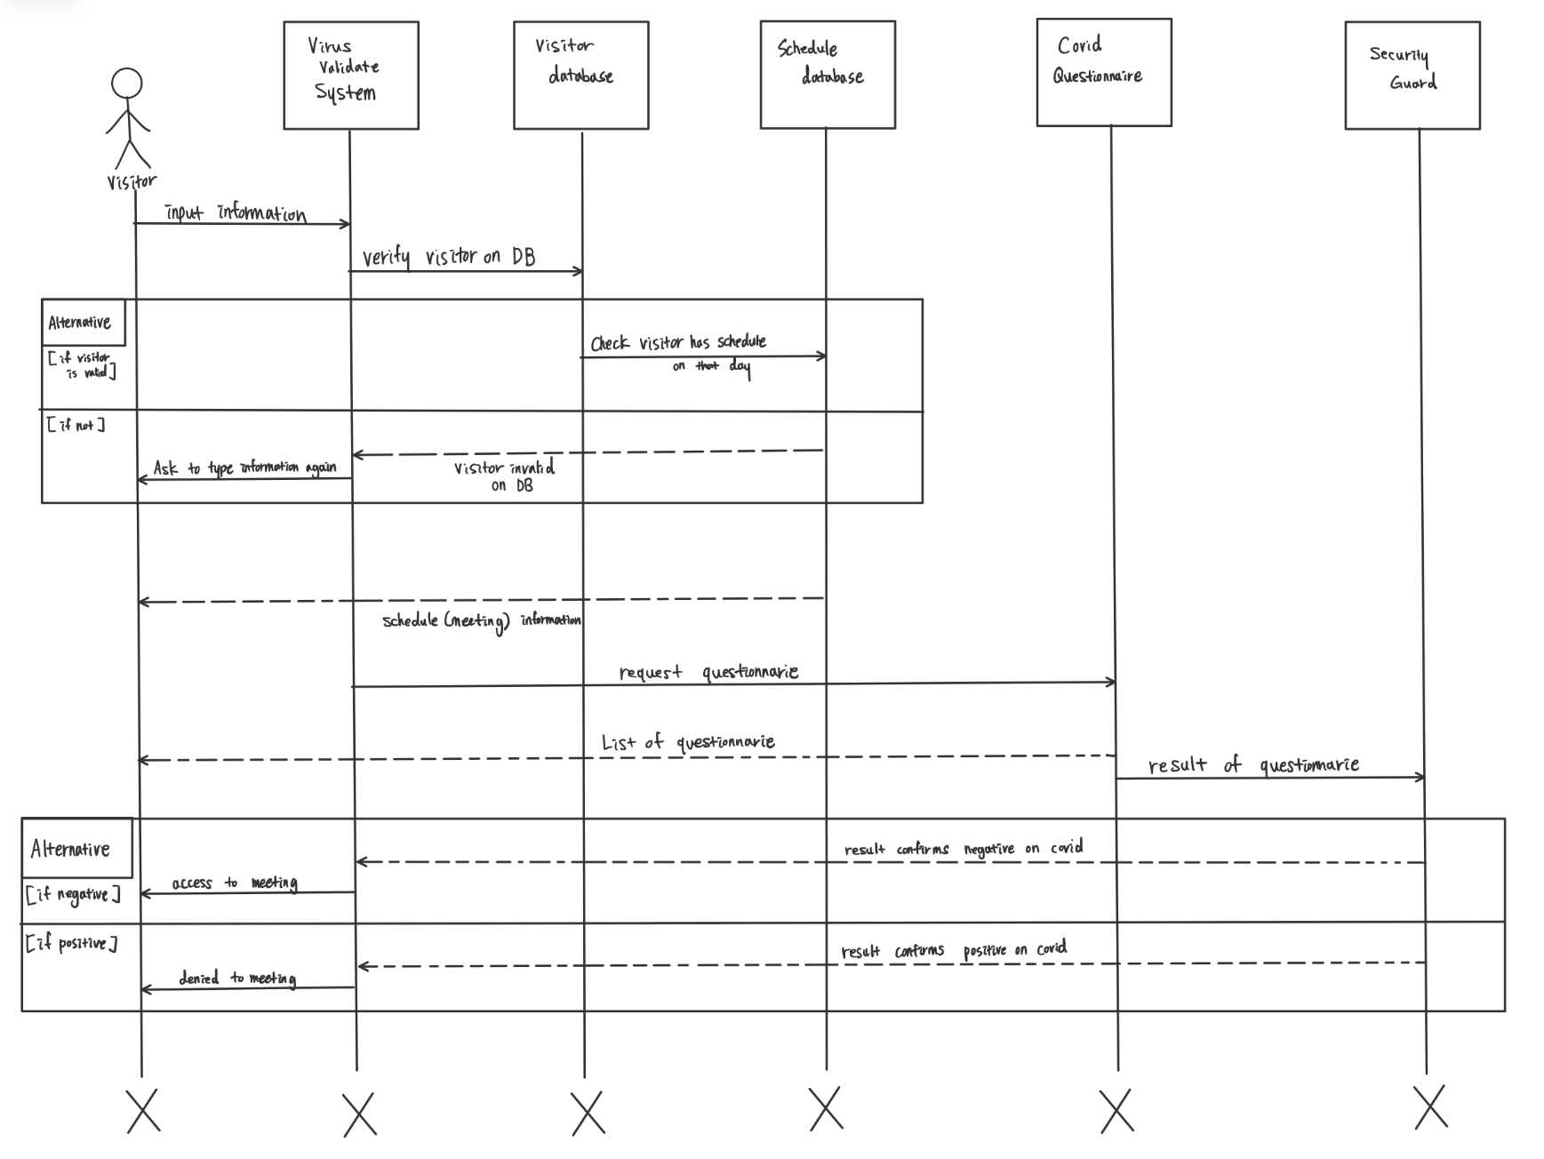
UML Sequence Diagram

Slide 3
Test Case Scenario - Info Verification
Scenario: When Mary comes to attend the meeting, she is presented with a digital form that will allow her to input her personal information as well as the meeting code that was assigned to her in advance. After inputting the information, she submits the form and waits to see if the information given is correct.

Slide 4
Test Case Scenario - Info Verification
Inputs
Participant’s Name
Participant’s Birthday
A number that represents the meeting’s code to validate (CRN number)
Tests
Tests for input when name is not found
Tests for input when the CRN code is not found
Tests for input when birthday does not match with User’s info
Tests for input when one or more answer prompt is left blank
Output
Information is verified and approved by User’s Database, and website prompts user with COVID questionnaire.
Information is not verified by User’s Database and displays an error message in which the user can try again.

Slide 5
Test Case Scenario - Answering COVID Questionnaire
Scenario: After being directed to the correct scheduled meeting, John is prompted with the COVID questionnaire. The questionnaire is a series of Yes/No questions that he must answer before submitting, so John goes through the questionnaire clicking either “Yes” or “No” for each question. However, on one question, he mistakenly clicks on both “Yes” and “No”. Additionally, he realizes on another question he may have clicked on the wrong answer, so he is forced to switch from “Yes” to “No”. Finally, he accidentally submits the questionnaire not having answered one of the questions.

Slide 6
Test Case Scenario - Answering COVID Questionnaire (continued)
Inputs:
User clicks on both “Yes” and “No” button.
User clicks on “Yes” button, then user clicks on “No” button.
User does not click on any answer for one of the questions.
Tests:
Inputs where the user tries to click multiple answers.
Inputs where the user tries to change answer from one to the other.
Inputs where the user does not click any answer.
Outputs:
Only one answer can be selected at a time, so output shows a filled circle next to the currently selected answer.
Output visually shows filled circle change to other selected answer.
Output warns user with a prompt that a question may not be answered. Ok if user submits at this point, but question will be counted against the user.

Slide 7
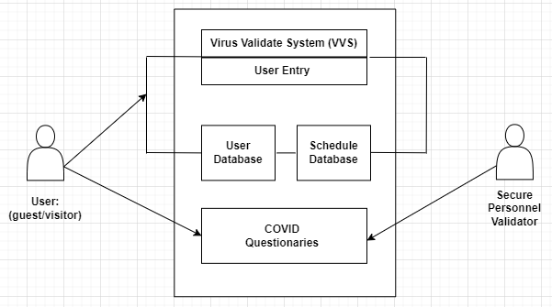
Use Case Diagram - 1

Slide 8
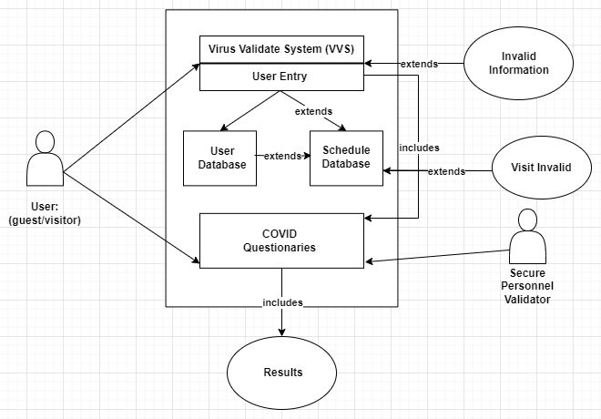
Use Case Diagram - 2

